Slide 1
Object-Oriented Programming Using C++
Third Edition
Understanding Inheritance

Slide 2
Objectives
Learn about inheritance and its benefits
Create a derived class
Learn about restrictions imposed with inheritance
Choose a class access specifier
Override inherited access
Override and overload parent class functions within a child class
Object-Oriented Programming Using C++, Third Edition

Slide 3
Objectives (continued)
Provide for a base class constructor within a derived class
Use multiple inheritance
Learn about the special problems posed by multiple inheritance
Use virtual inheritance
Object-Oriented Programming Using C++, Third Edition

Slide 4
Understanding Inheritance
If you need to write a program using a new class named FirstYearStudent, the job is easier if FirstYearStudent is inherited from an already existent class named Student
  FirstYearStudent may require some additional data members and functions (e.g., applicationFee or orientation())
  FirstYearStudent will also have the more general Student members
  The FirstYearStudent class might require a different display format than the Student class
Object-Oriented Programming Using C++, Third Edition

Slide 5
Understanding Inheritance (continued)
FirstYearStudent inherits from Student, or is derived from it
Student is called a parent class, base class, superclass, or ancestor
FirstYearStudent is called a child class, derived class, subclass, or descendant
When you override a function, you substitute one version of the function for another
Object-oriented programmers say that inheritance supports generalization and specialization
Object-Oriented Programming Using C++, Third Edition

Slide 6
Understanding the Advantages Provided by Inheritance
Programs in which you derive new classes from existing classes offer several advantages:
  Much of the code is already written
  Existing code has already been tested; it is reliable
  You already understand how the base class works, and you can concentrate on writing the extensions
  You can extend and revise a parent class without corrupting the existing parent class features
  If other classes have been derived from the parent class, the parent class is even more reliable
Object-Oriented Programming Using C++, Third Edition

Slide 7
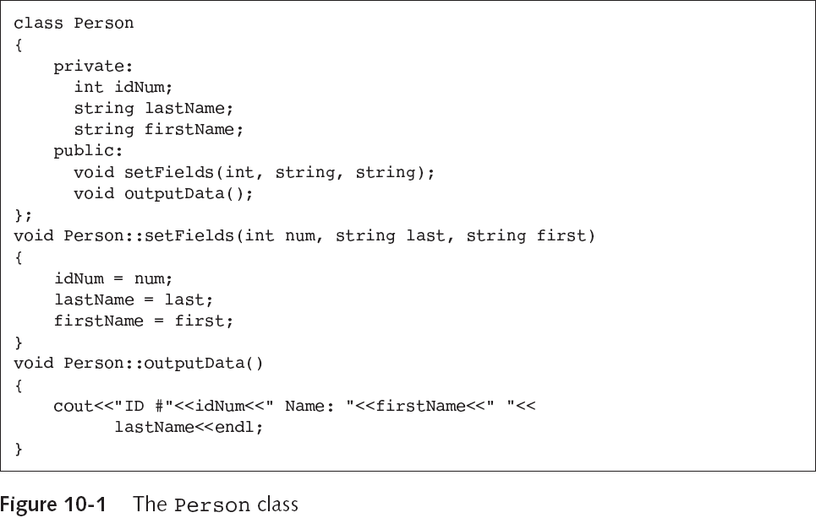
Creating a Derived Class
Object-Oriented Programming Using C++, Third Edition

Slide 8
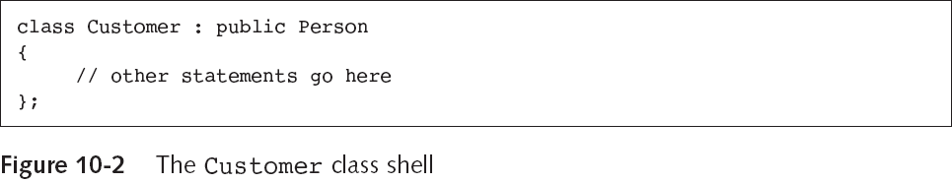
Creating a Derived Class (continued)
You can say every child class object “is a” parent class object
  For example, every Customer “is a” Person
The Customer class shown above contains all the members of Person because it inherits them
Object-Oriented Programming Using C++, Third Edition

Slide 9
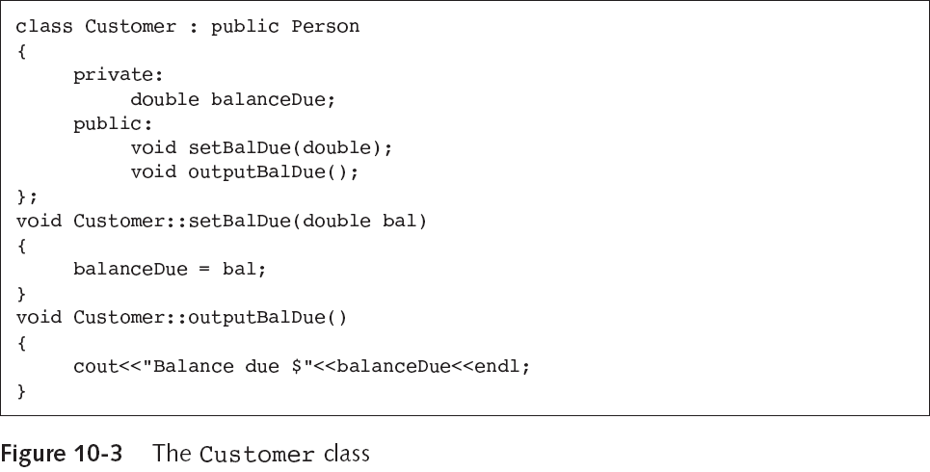
Creating a Derived Class (continued)
Object-Oriented Programming Using C++, Third Edition

Slide 10
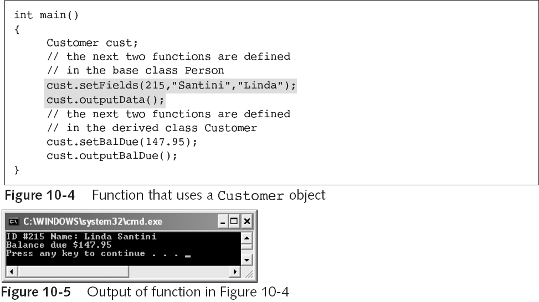
Creating a Derived Class (continued)
Object-Oriented Programming Using C++, Third Edition

Slide 11
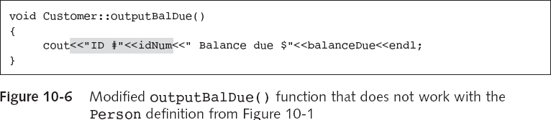
Understanding Inheritance Restrictions
If you replace the original outputBalDue() function with the one shown above, programs that use the function no longer run
The private Person field idNum is inaccessible
Object-Oriented Programming Using C++, Third Edition

Slide 12
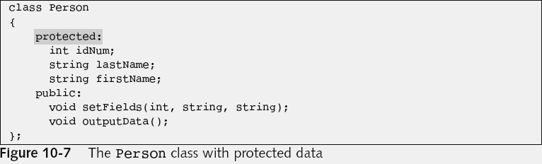
Understanding Inheritance Restrictions (continued)
private members can be accessed only within a class
protected members can be accessed only by class functions, or by functions in child classes
public members can be accessed anywhere
Object-Oriented Programming Using C++, Third Edition

Slide 13
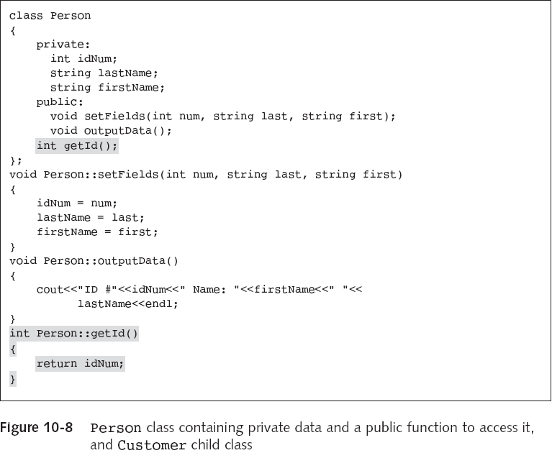
Object-Oriented Programming Using C++, Third Edition

Slide 14
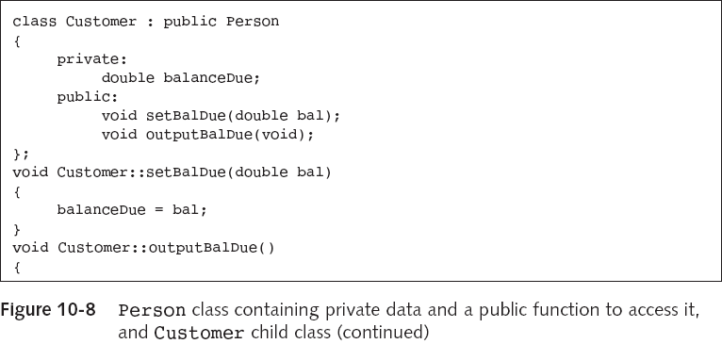
Understanding Inheritance Restrictions (continued)
Object-Oriented Programming Using C++, Third Edition

Slide 15
Understanding Inheritance Restrictions (continued)
The following are never inherited:
  constructors
  destructors
  friend functions
  overloaded new operators
  overloaded = operators
Class friendship is not inherited
Object-Oriented Programming Using C++, Third Edition

Slide 16
Choosing the Class Access Specifier
You can write any of the following to indicate that a Customer is a Person:
  class Customer : public Person
  class Customer : protected Person
  class Customer : private Person
If a derived class uses public for inheritance:
  public base class members remain public
  protected base class members remain protected
  private base class members are inaccessible
Object-Oriented Programming Using C++, Third Edition

Slide 17
Choosing the Class Access Specifier (continued)
If a derived class uses protected for inheritance:
  public base class members become protected
  protected base class members remain protected
  private base class members are inaccessible
If a derived class uses private for inheritance:
  public base class members become private
  protected base class members become private
  private base class members are inaccessible
Object-Oriented Programming Using C++, Third Edition

Slide 18
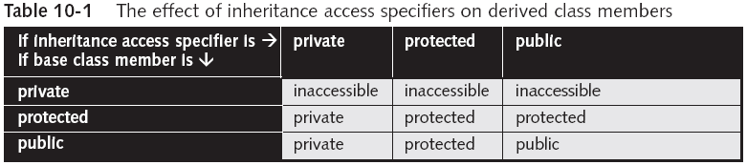
Choosing the Class Access Specifier (continued)
If you don’t use an access specifier when creating a derived class, access is private by default
A class’s private data can be accessed only by a class’s member functions
The inheritance access specifier in derived classes is most often public
Object-Oriented Programming Using C++, Third Edition

Slide 19
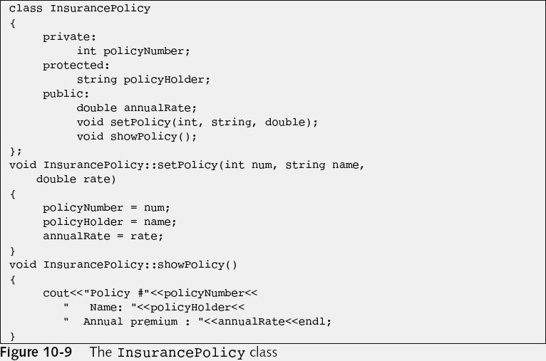
Overriding Inherited Access
Object-Oriented Programming Using C++, Third Edition

Slide 20
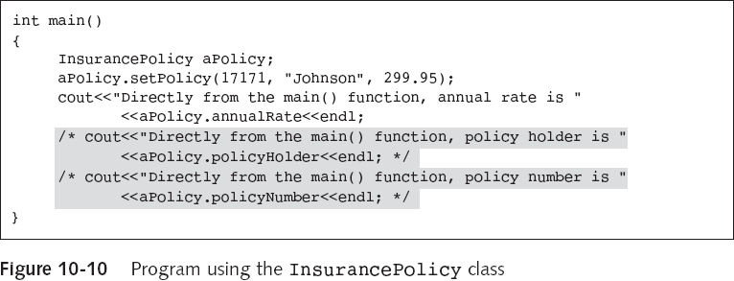
Overriding Inherited Access (continued)
You cannot access protected or private members of the class
Object-Oriented Programming Using C++, Third Edition

Slide 21
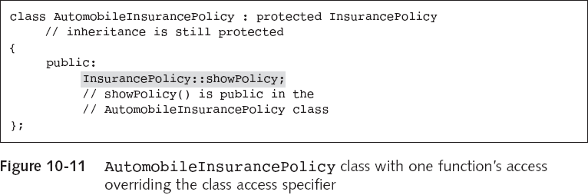
Overriding Inherited Access (continued)
Access for showPolicy() is public within AutomobileInsurancePolicy, even though all other public members of InsurancePolicy are protected within the child
Object-Oriented Programming Using C++, Third Edition

Slide 22
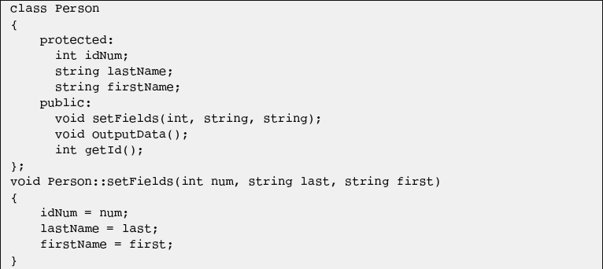
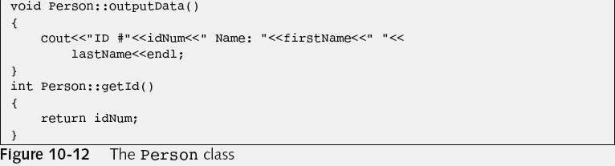
Overriding and Overloading Parent Class Functions
Object-Oriented Programming Using C++, Third Edition

Slide 23
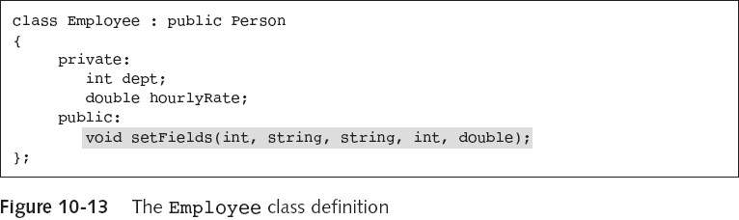
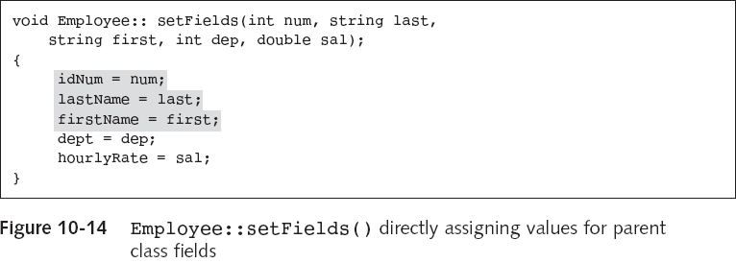
Overriding and Overloading Parent Class Functions (continued)
Object-Oriented Programming Using C++, Third Edition

Slide 24
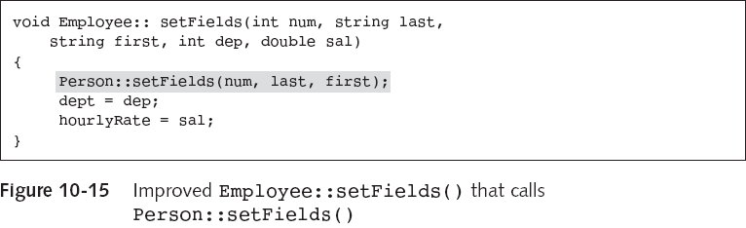
Overriding and Overloading Parent Class Functions (continued)
The following version of the setFields() function requires less work on your part and takes advantage of code reusability
And, it could be used even if the data fields in Person were declared to be private rather than protected
Object-Oriented Programming Using C++, Third Edition

Slide 25
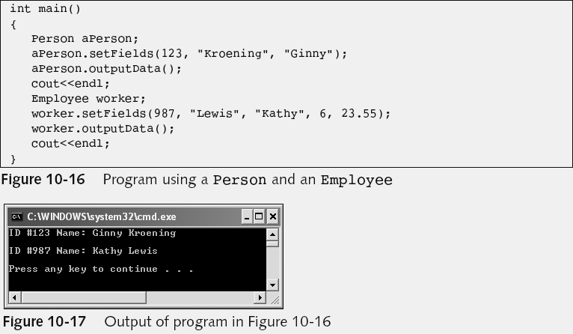
Overriding and Overloading Parent Class Functions (continued)
Same outputData() function is used
Object-Oriented Programming Using C++, Third Edition

Slide 26
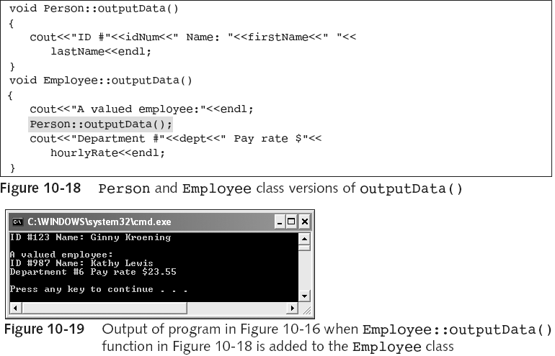
Overriding and Overloading Parent Class Functions (continued)
overrides the outputData() function defined in Person
Object-Oriented Programming Using C++, Third Edition

Slide 27
Overriding and Overloading Parent Class Functions (continued)
You can use the Person version of a function in an Employee object by using the following syntax
  worker.Person::setFields(id,last,first);
aPerson = worker; causes each data member to be copied from worker to aPerson; it leaves off data for which the base class doesn’t have members
  The reverse assignment cannot take place without writing a specialized function
If a base class contains a function that the derived class should not have, you can create a dummy function with the same name in the derived class
Object-Oriented Programming Using C++, Third Edition

Slide 28
Overriding and Overloading Parent Class Functions (continued)
When any class member function is called, the following steps take place:
  The compiler looks for a matching function in the class of the object using the function name
  If no match is found in this class, the compiler looks for a matching function in the parent class
  If no match is found in the parent class, the compiler continues up the inheritance hierarchy, looking at the parent of the parent, until the base class is reached
  If no match is found in any class, an error message is issued
Object-Oriented Programming Using C++, Third Edition

Slide 29
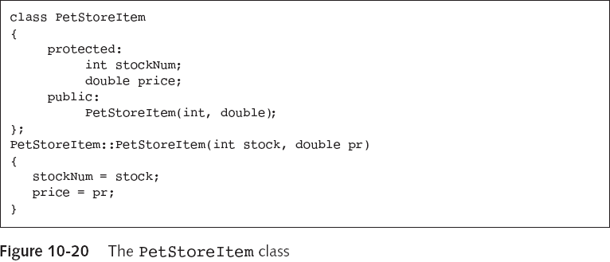
Providing for Base Class Construction
Object-Oriented Programming Using C++, Third Edition

Slide 30
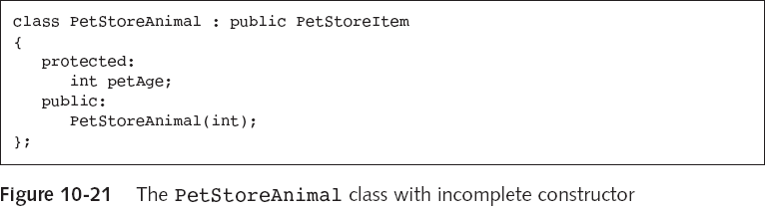
Providing for Base Class Construction (continued)
When a child class object is instantiated, a PetStoreItem object is constructed first, and the PetStoreItem class constructor is called
  The PetStoreItem constructor requires arguments for stockNum and price, so those arguments have to be provided to the constructor
Object-Oriented Programming Using C++, Third Edition

Slide 31
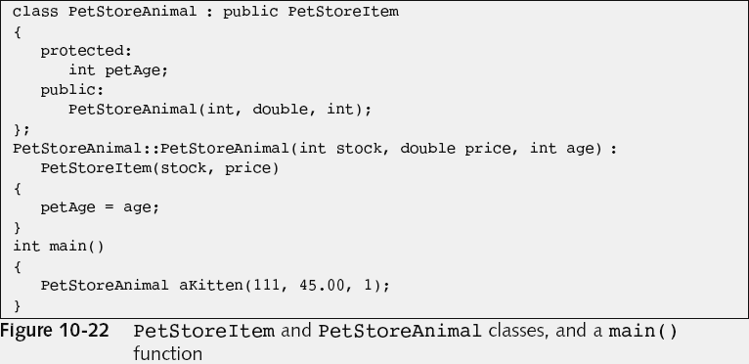
Providing for Base Class Construction (continued)
Object-Oriented Programming Using C++, Third Edition

Slide 32
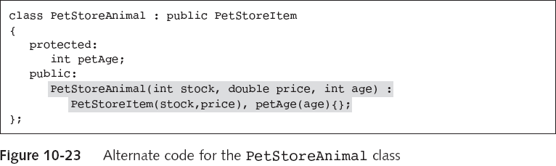
Providing for Base Class Construction (continued)
When a derived class object is destroyed the child class destructor is called first and the base class destructor is called last
Object-Oriented Programming Using C++, Third Edition

Slide 33
Using Multiple Inheritance
When a child class derives from a single parent, you are using single inheritance
A child class can also derive from more than one base class; this is called multiple inheritance
  An RV is both a Dwelling and a Vehicle
  Multiple inheritance speeds development of the RV class
Object-Oriented Programming Using C++, Third Edition

Slide 34
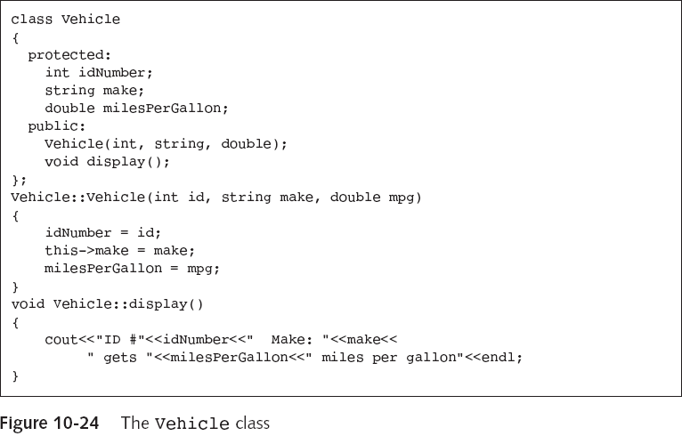
Using Multiple Inheritance (continued)
Object-Oriented Programming Using C++, Third Edition

Slide 35
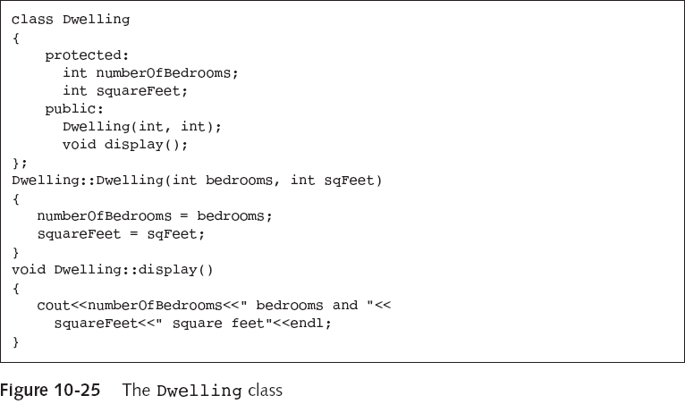
Using Multiple Inheritance (continued)
Object-Oriented Programming Using C++, Third Edition

Slide 36
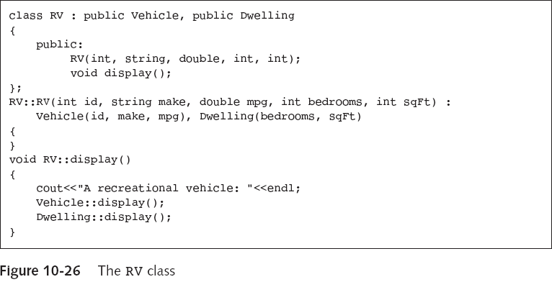
Using Multiple Inheritance (continued)
Object-Oriented Programming Using C++, Third Edition

Slide 37
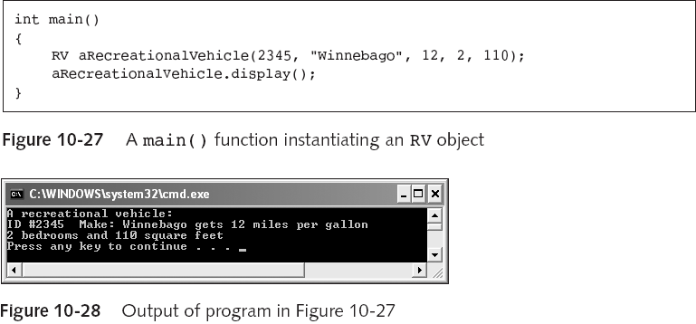
Using Multiple Inheritance (continued)
Object-Oriented Programming Using C++, Third Edition

Slide 38
Disadvantages of Using Multiple Inheritance
Multiple inheritance is never required to solve a programming problem
  For example, the RV class could be written to inherit from Vehicle, but could contain a Dwelling
If two parent classes contain members with the same name then you must use the resolution operator when working with those members
The definition of a class that inherits from a single parent is almost always easier to understand and less prone to error
Object-Oriented Programming Using C++, Third Edition

Slide 39

Using Virtual Base Classes
To avoid this duplicate inheritance, use the keyword virtual:
  class Student : virtual public Person, and
  class Employee : virtual public Person, or
  class StudentEmployee : virtual public Student, virtual public Employee
Object-Oriented Programming Using C++, Third Edition

Slide 40
Using Virtual Base Classes (continued)
Handling constructors with multiple inheritance can be complicated
  If Person requires values for ID number and name, Student requires a grade point average, Employee requires an hourly rate, and StudentEmployee requires a limit on the number of hours allowed to work per week:
    StudentEmployee (int idNum, string name, double gradePoint, double hourlyRate, int workHoursLimit) : StudentEmployee (workHoursLimit), Person(idNum, name), Student(gradePoint), Employee(hourlyRate) { };
Object-Oriented Programming Using C++, Third Edition

Slide 41
You Do It: Creating a Base Class
class Car
{
private:
bool isIgnitionOn;
int speed;
public:
void turnIgnitionOn();
void turnIgnitionOff();
void setSpeed(int);
void showCar();
};
Object-Oriented Programming Using C++, Third Edition

Slide 42
Creating a Child Class
class Convertible: public Car
{
private:
bool isTopUp;
public:
void putTopUp();
void putTopDown();
void showCar();
};
Object-Oriented Programming Using C++, Third Edition

Slide 43
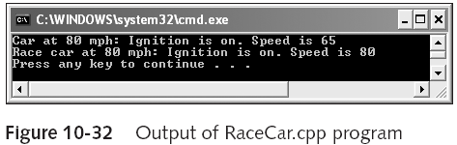
Creating Another Child Class
class RaceCar : public Car
{
public:
void setSpeed(int mph);
};
Object-Oriented Programming Using C++, Third Edition

Slide 44
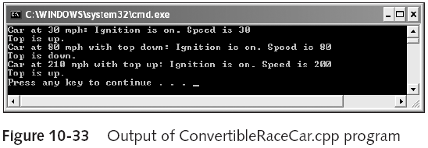
Using Multiple Inheritance
class ConvertibleRaceCar : public Convertible, public RaceCar
{
};
Object-Oriented Programming Using C++, Third Edition

Slide 45
Summary
Inheritance in C++ means you can create classes that derive their attributes from existing classes
To be truly “object-oriented,” a programming language must allow inheritance
To create a derived class, you include the keyword class, the derived class name, a colon, a class access specifier, the base class name, an opening brace, class definition statements, a closing brace, and a semicolon
All members of a base class are included when you create an object from a derived class
Object-Oriented Programming Using C++, Third Edition

Slide 46
Summary (continued)
When you define a derived class, you can insert one of the three class access specifiers prior to the base class name
C++ programmers usually use the public access specifier for inheritance
Nine inheritance access specifier combinations are possible
Any child class function with the same name and argument list as the parent overrides the parent function
Object-Oriented Programming Using C++, Third Edition

Slide 47
Summary (continued)
When you instantiate a class object that has been derived from another class, a constructor for the base class is called first, followed by the derived class constructor
A base class may have many derived classes
Some programmers are vehemently opposed to using multiple inheritance
When a class descends from two classes that both descend from the same base class, you need to prevent duplicate inheritance of the base class
Object-Oriented Programming Using C++, Third Edition

